Slide 1

DATA MINING 1 Probabilistic classification Naïve Bayes Classifiers
Fosca Giannotti
a.a. 2024/2025
Slides edited from Tan, Steinbach, Kumar, Introduction to Data Mining (chapter 4 sez. 4)

Slide 2
Probability Notions and Bayes Theorem
A probabilistic framework for solving classification problems.
Let P be a probability function that assigns a number between 0 and 1 to events.
X = x an events is happening.
P(X = x) is the probability that events X = x.
Joint Probability P(X = x, Y = y)
Conditional Probability P(Y = y | X = x) = P(X,Y)/ P(X)
Notice that: P(X,Y) = P(Y|X) P(X) = P(X|Y) P(Y)
Bayes Theorem: P(Y|X) = P(X|Y)P(Y) / P(X)
Another Useful Property: P(X =x) = P(X=x, Y=0) + P(X=x, Y=1)

Slide 3
Bayes Theorem: Example
Consider a football game.
Team 0 wins 65% of the time,
Team 1 the remaining 35%.
Among the game won by Team 1, 75% of them are won playing at home.
Among the games won by Team 0, 30% of them are won at Team 1’s field.
If Team 1 is hosting the next match, which team will most likely win?
Team 0 wins: P(Y = 0) = 0.65
Team 1 wins: P(Y = 1) = 0.35
Team 1 hosted the match won by Team 1: P(X = 1|Y = 1) = 0.75
Team 1 hosted the match won by Team 0: P(X = 1|Y = 0) = 0.30
Objective P(Y = 1|X = 1)

Slide 4
Bayes Theorem: Example
P(Y = 1|X = 1) = P(X = 1|Y = 1)P(Y = 1) / P(X = 1) =
= 0.75 x 0.35 / (P(X = 1, Y = 1) + P(X = 1, Y = 0))
= 0.75 x 0.35 / (P(X = 1|Y = 1)P(Y=1) + P(X = 1|Y = 0)P(Y=0))
= 0.75 x 0.35 / (0.75 x 0.35 + 0.30 x 0.65)
= 0.5738
Therefore Team 1 has a better chance to win the match

Slide 5
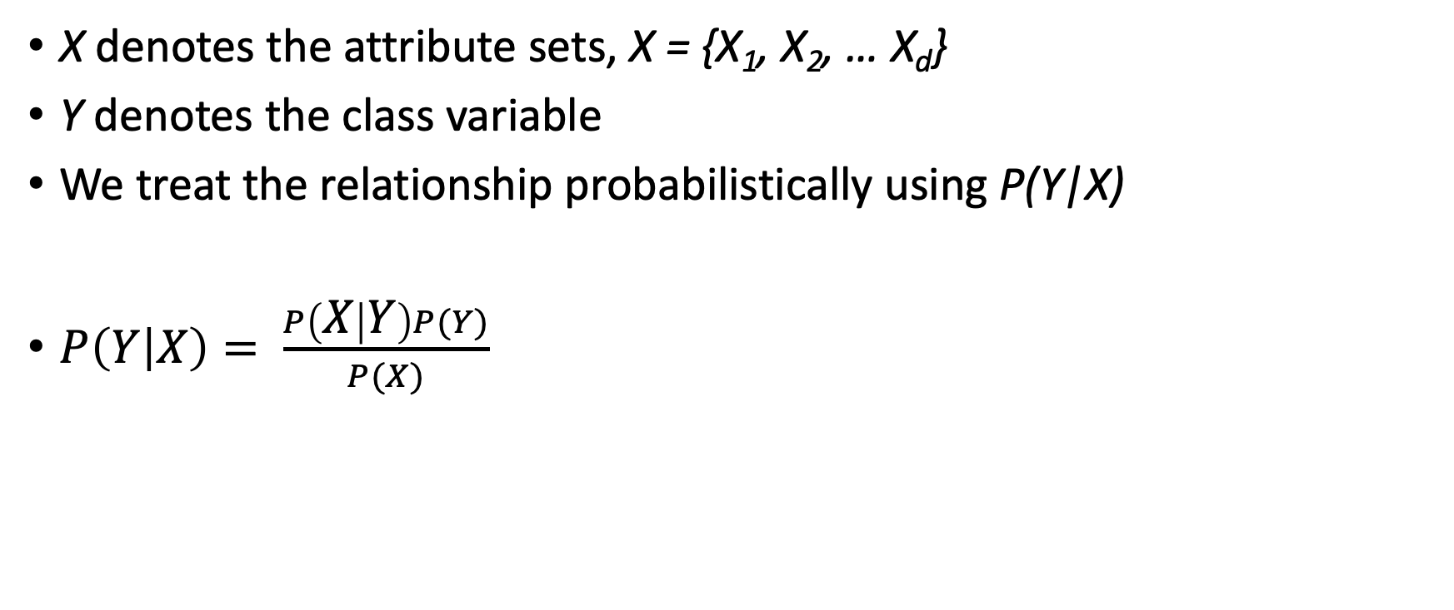
Bayes Theorem for Classification
X denotes the attribute sets, X = {X₁, X₂, … X_{d}}
Y denotes the class variable
We treat the relationship probabilistically using P(Y|X)
$P\left(Y | X\right)= \frac{P\left(X | Y\right)P(Y)}{P(X)}$
Likelihood
Prior
Probability
Posterior
Probability
Evidence
(sum over alternative events)

Slide 6
Bayes Theorem for Classification
Learn the posterior P(Y | X) for every combination of X and Y.
By knowing these probabilities, a test record X’ can be classified by finding the class Y’ that maximizes the posterior probability P(Y’|X’).
This is equivalent of choosing the value of Y’ that maximizes P(X’|Y’)P(Y’).
How to estimate it?

Slide 7
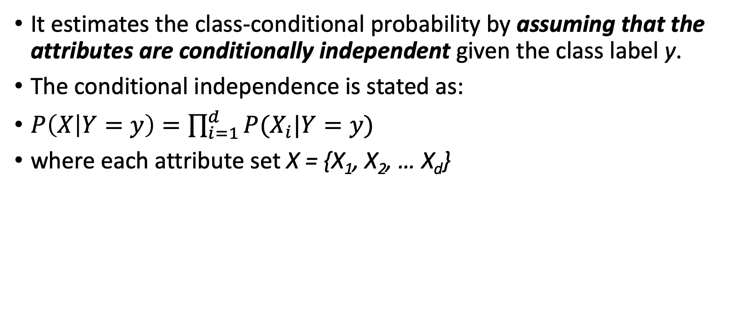
Naïve Bayes Classifier
It estimates the class-conditional probability by assuming that the attributes are conditionally independent given the class label y.
The conditional independence is stated as:
$P\left(X | Y=y\right)=\prod_{i=1}^{d}{P(X_{i}|Y=y)}$
where each attribute set X = {X₁, X₂, … X_{d}}

Slide 8
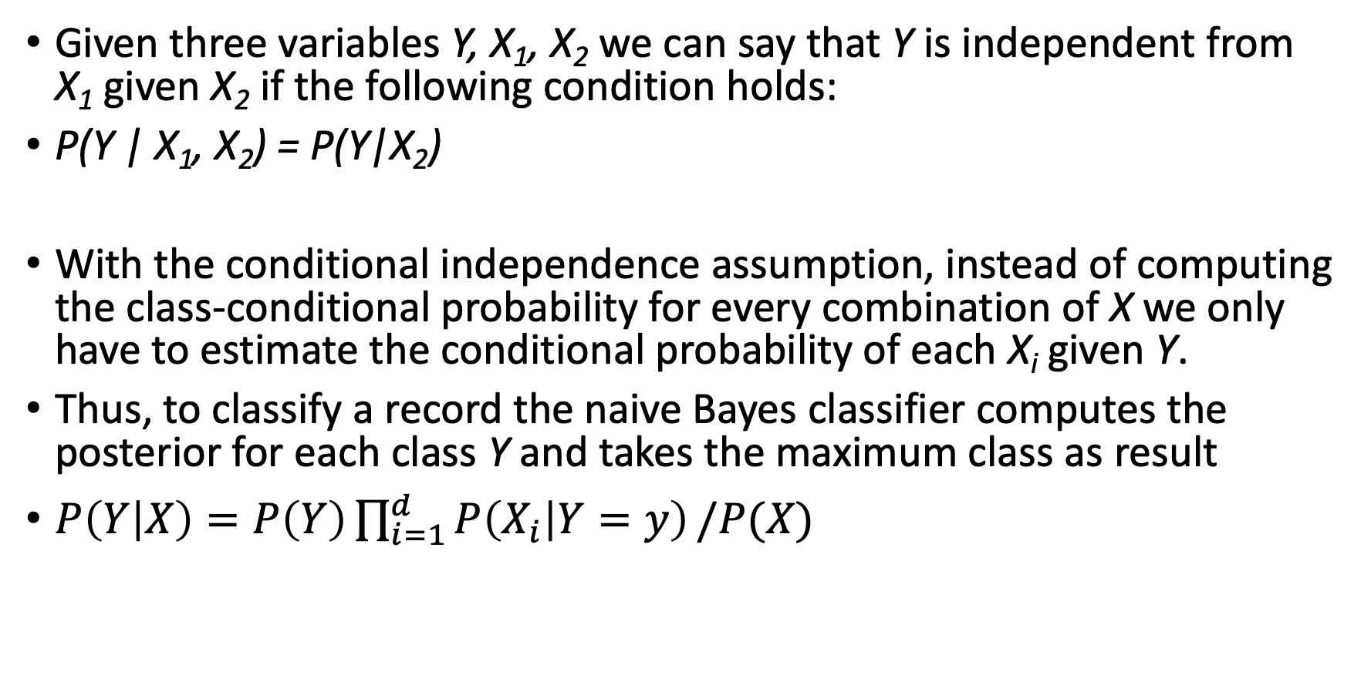
Conditional Independence
Given three variables Y, X₁, X₂ we can say that Y is independent from X₁ given X₂ if the following condition holds:
P(Y | X₁, X₂) = P(Y|X₂)
With the conditional independence assumption, instead of computing the class-conditional probability for every combination of X we only have to estimate the conditional probability of each X_{i} given Y.
Thus, to classify a record the naive Bayes classifier computes the posterior for each class Y and takes the maximum class as result
$P\left(Y | X\right)=P\left(Y\right)\prod_{i=1}^{d}{P\left(X_{i} | Y=y\right)}/P(X)$
How to estimate ?

Slide 9
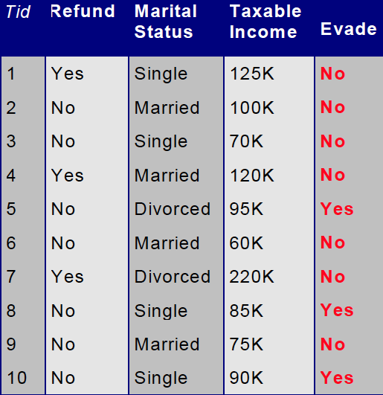
How to Estimate Probability From Data
Class P(Y) = N_{y}/ N
N_{y} number of records with outcome y
N number of records
Categorical attributes
P(X = x | Y = y) = N_{xy} / N_{y}
N_{xy} records with value x and outcome y
P(Evade = Yes) = 3/10
P(Marital Status = Single|Yes) = 2/3

Slide 10
How to Estimate Probability From Data
Continuous attributes
Discretize the range into bins
one ordinal attribute per bin
violates independence assumption
Two-way split: (X < v) or (X > v)
choose only one of the two splits as new attribute
Probability density estimation:
Assume attribute follows a normal distribution
Use data to estimate parameters of distribution (e.g., mean and standard deviation)
Once probability distribution is known, can use it to estimate the conditional probability P(X|y)

Slide 11
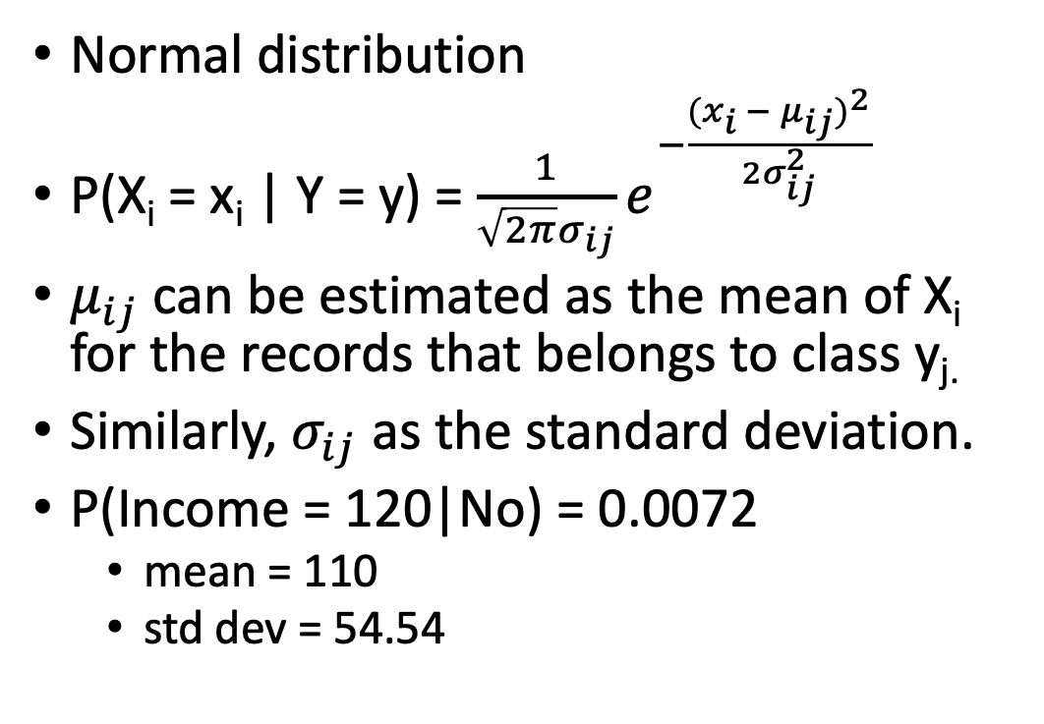
How to Estimate Probability From Data
Normal distribution
P(X_{i} = x_{i} | Y = y) = $\frac{1}{\sqrt{2π}σ_{ij}}e^{−\frac{{{(x}_{i} − μ_{ij})}^{2}}{2σ_{ij}^{2}}}$
$μ_{ij}$ can be estimated as the mean of X_{i} for the records that belongs to class y_{j.}
Similarly, $σ_{ij}$ as the standard deviation.
P(Income = 120|No) = 0.0072
mean = 110
std dev = 54.54

Slide 12
Example
Given X = {Refund = No, Married, Income = 120k}
P(Refund=Yes|No) = 3/7
P(Refund=No|No) = 4/7
P(Refund=Yes|Yes) = 0
P(Refund=No|Yes) = 1
P(Marital Status=Single|No) = 2/7
P(Marital Status=Divorced|No)=1/7
P(Marital Status=Married|No) = 4/7
P(Marital Status=Single|Yes) = 2/3
P(Marital Status=Divorced|Yes)=1/3
P(Marital Status=Married|Yes) = 0/3
For taxable income:
If class=No:
mean=110, variance=2975
If class=Yes:
mean=90, variance=25
P(X|Class=No) = P(Refund=No|Class=No)
× P(Married| Class=No)
× P(Income=120K| Class=No)
= 4/7 × 4/7 × 0.0072
= 0.0024
P(X|Class=Yes) = P(Refund=No| Class=Yes)
× P(Married| Class=Yes)
× P(Income=120K| Class=Yes)
= 1 × 0 × 1.2 × 10-9
= 0
Since P(X|No)P(No) > P(X|Yes)P(Yes)
Therefore P(No|X) > P(Yes|X)
=> Class = No

Slide 13
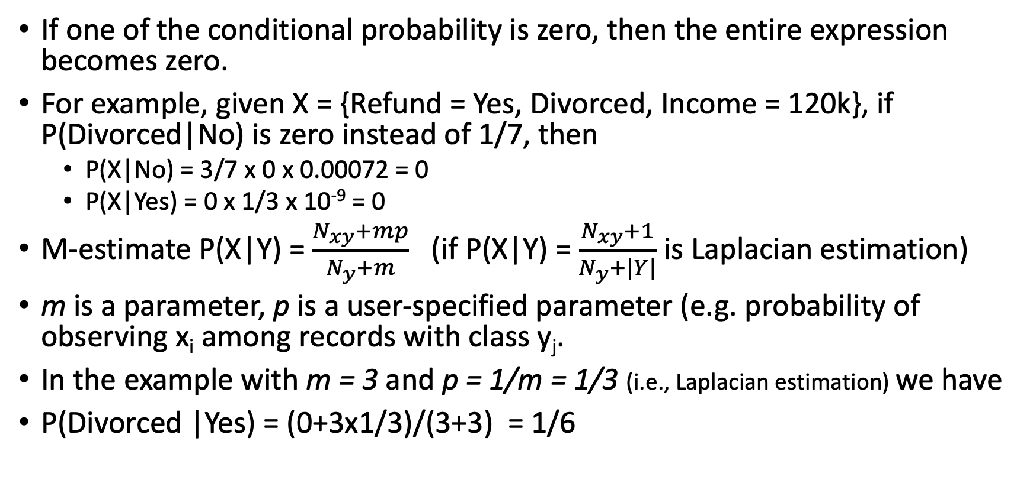
M-estimate of Conditional Probability
If one of the conditional probability is zero, then the entire expression becomes zero.
For example, given X = {Refund = Yes, Divorced, Income = 120k}, if P(Divorced|No) is zero instead of 1/7, then
P(X|No) = 3/7 x 0 x 0.00072 = 0
P(X|Yes) = 0 x 1/3 x 10⁻⁹ = 0
M-estimate P(X|Y) = $\frac{N_{xy}+mp}{N_{y}+m}$ (if P(X|Y) = $\frac{N_{xy}+1}{N_{y}+|Y|}$ is Laplacian estimation)
m is a parameter, p is a user-specified parameter (e.g. probability of observing x_{i} among records with class y_{j}.
In the example with m = 3 and p = 1/m = 1/3 (i.e., Laplacian estimation) we have
P(Divorced |Yes) = (0+3x1/3)/(3+3) = 1/6

Slide 14
Naïve Bayes Classifier
Robust to isolated noise points
Handle missing values by ignoring the instance during probability estimate calculations
Robust to irrelevant attributes
Independence assumption may not hold for some attributes
Use other techniques such as Bayesian Belief Networks (BBN, not treated in this course)

Slide 15
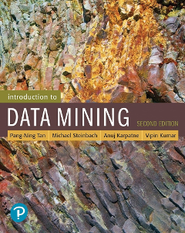
References
Bayesian Classifiers. Chapter 5.3. Introduction to Data Mining.

Slide 16
Exercises - NBC
Notes:
Explainable-AI explores and investigates methods to produce or complement AI models to make accessible and interpretable the internal logic and the outcome of the algorithms, making such process understandable by humans.
Explicability, understood as incorporating both intelligibility (“how does it work?”) for non-experts, e.g., patients or business customers, and for experts, e.g., product designers or engineers) and accountability (“who is responsible for”).

Slide 17
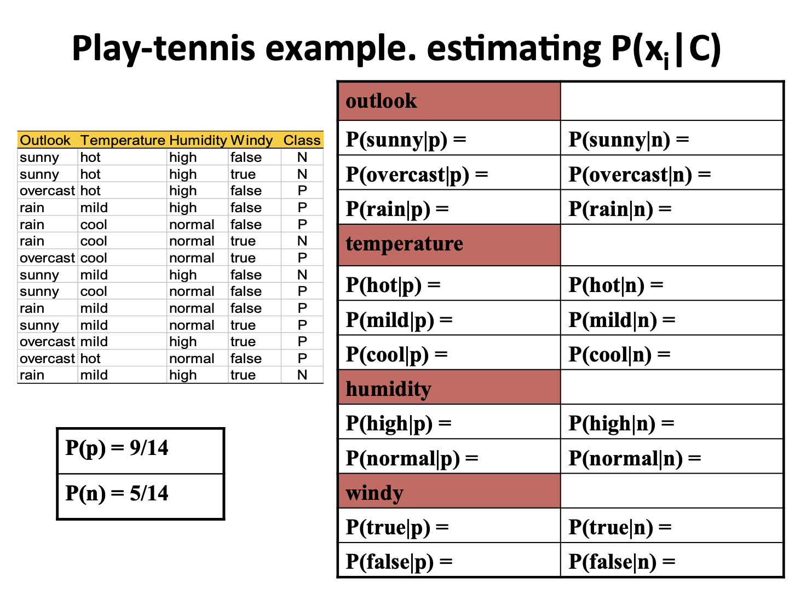

Slide 18
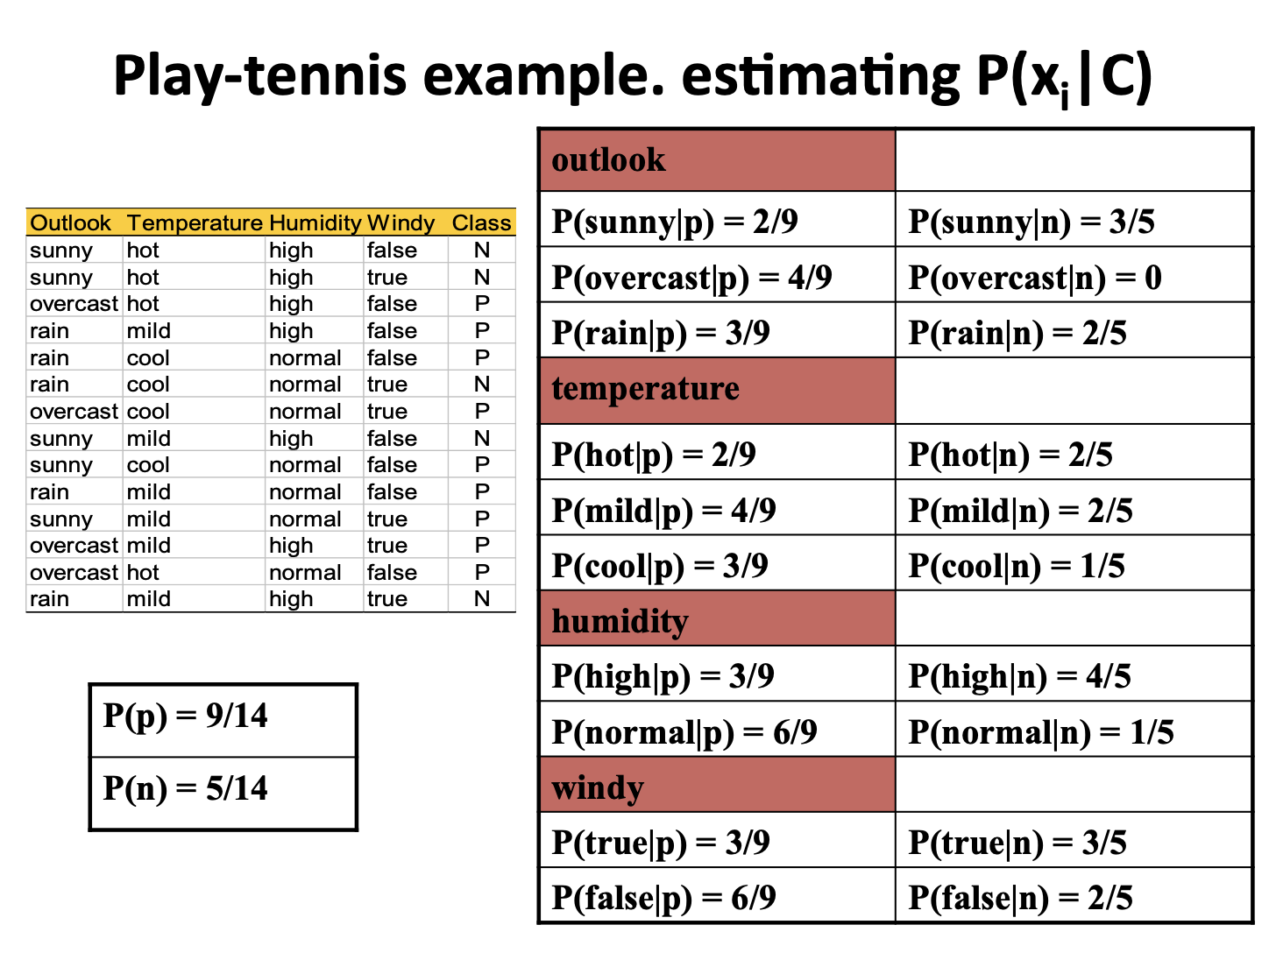

Slide 19
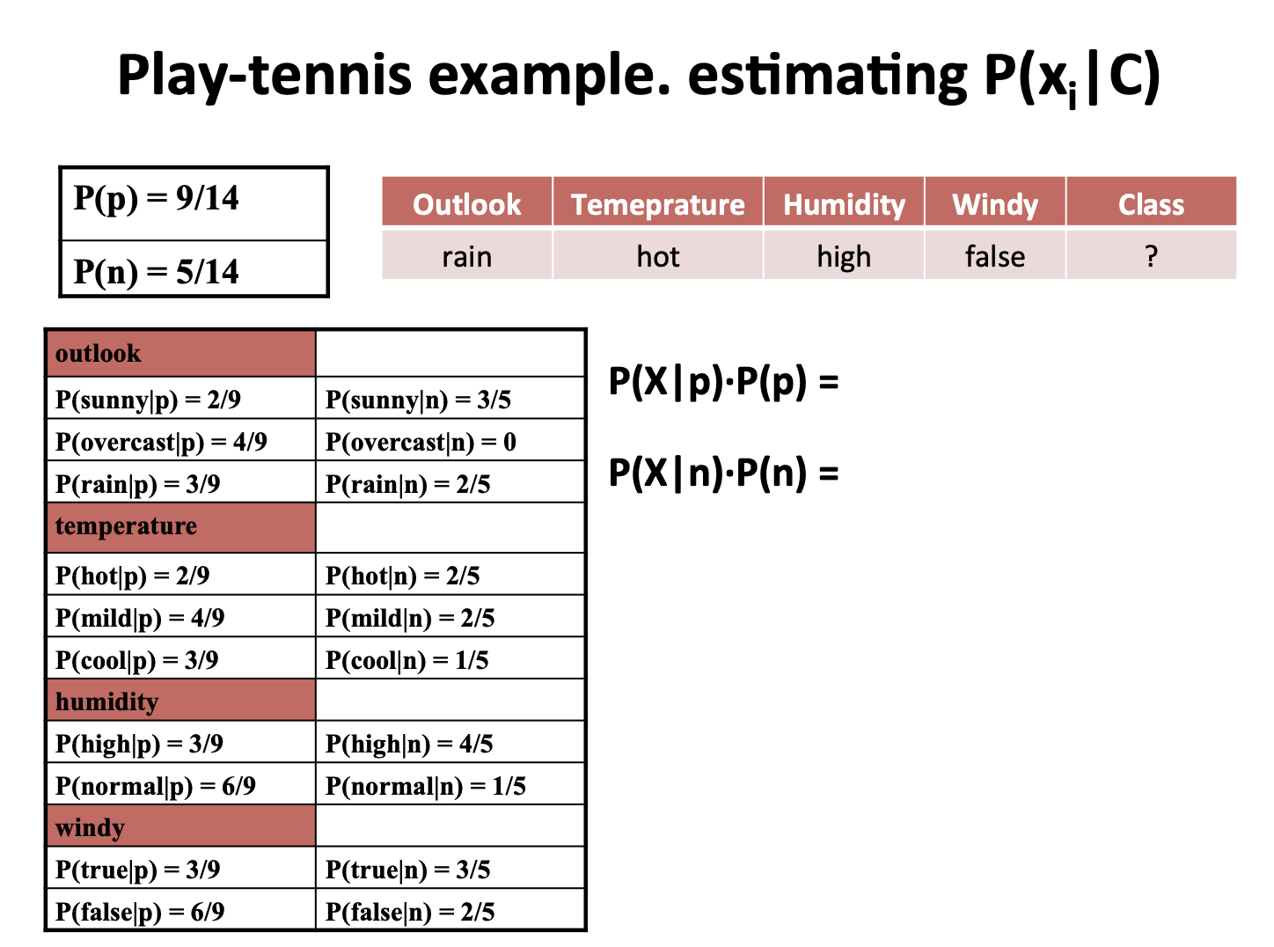

Slide 20
